Slide 1
KNOWLEDGE MANAGEMENT

Slide 2



What Is Knowledge ?
Data
Information
Knowledge
A Record of a
Change of State
Data organized with
a purpose. A message
Literally…
what people know
“that’s not a good flight; Often busy and delayed”
“1840KL0617”“
“The flight from Amman leaves at 18:40

Slide 3
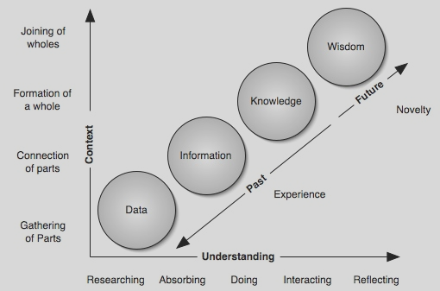
The Continuum of Understanding

Slide 4
Defining knowledge
“Knowledge is information that changes something or somebody -- either by becoming grounds for actions, or by making an individual (or an institution) capable of different or more effective action.” - Peter F. Drucker

Slide 5
Attributes of Knowledge
Knowledge exists everywhere
Knowledge is perishable
Knowledge is an asset
Use of knowledge does not consume it.
Transfer of knowledge does not result in losing it.
Knowledge is abundant, but the ability to use it is scarce.
Much of the organization’s knowledge goes out of the organization.
Knowledge can be tacit or explicit
Knowledge relates to place and context

Slide 6
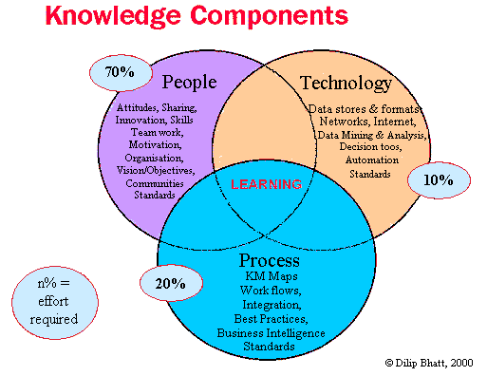

Slide 7
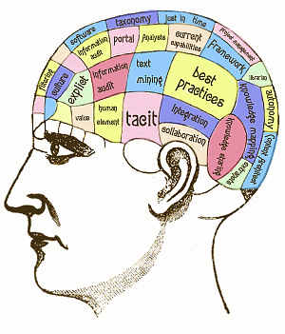
What is Knowledge Management?
Knowledge Management is a collection of activities, processes and policies that help organizations apply knowledge to improve effectiveness, innovation and quality.
The Purpose of KM is to turn personal knowledge into corporate knowledge and corporate knowledge into personal knowledge.

Slide 8
KM Definitions
(a) A collaborative and systematic process for acquiring, creating, synthesizing, and sharing information, insights, and experiences to achieve organizational goals.
(b) Knowledge Management refers to the processes and/or tools an organization uses to collect, analyze, store, and disseminate its intellectual capital. This intellectual capital can include training materials, processes, procedures, documents, ideas, skills, experiences, and much more.

Slide 9
Knowledge Management
Is not an organizational goal in itself
Is a means to achieving
Organizational effectiveness and efficiency
Development results
Is knowledge sharing
Strategic, systematic & process oriented
Requires change management
Individual attitudes and work habits
Team building
Organizational culture

Slide 10
Knowledge Management
The ability to create, communicate, and apply knowledge to achieve business goals.
Notes:
So my definition of KM is the ability to create, communicate, and apply knowledge to achieve business goals.
This means:
Learning from others to avoid reinventing the wheel
Sharing our experiences and insights so others can benefit
Knowing who the experts are and how to find them
In short, it is a formal management of the intellectual assets of the organization.

Slide 11
KM Benefits
Greater access to knowledge
Better maintenance of knowledge
Increased customer service levels
Reduce the need to increase resources
Reducing cycle times
Reducing overheads
Boosting revenues by getting products and services to market faster
Improving customer service by streamlining response time
Empowering employees
Notes:
Greater Access to Knowledge
One place to search, but ability to search multiple sources
Ability to contribute knowledge through the same tool, making it part of the daily workflow, not an additional task or burden
Reduced training time, bring new people up to speed quicker because they have the knowledge at their fingertips
Counteract “brain drain” when people leave the organization for one reason or another
More efficient for both Help Desk and end users
Maintenance
Many KMS tools have built in processes for quality assurance, including subject matter and periodic reviews of the knowledge in the KB
This helps ensure the accuracy and integrity of knowledge used by people in a department and made available to outside customers
Increased Customer Service Levels
More efficient and more accurate answers
Able to increase the scope and coverage of the support provided to students and the University community
Reduce the need to increase resources
Looking back at some of the drivers I mentioned that are causing us to explore KM, we take more calls and support more products every year. In order to provide the level of service that our customers expect, we can either add more people to handle those calls or help the people who are taking the calls today be more efficient and productive.

Slide 12
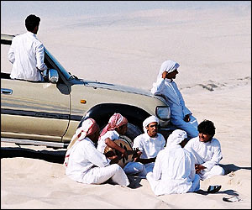
Best Knowledge Transfer Technology
Face-to-Face Interaction
Not always possible but everything else aspires to it
Best Knowledge Repository
A Community or Group of people is the best repository of knowledge
Collection and codification are still important!
Notes:
Key Point: The most efficient and effective way to transfer knowledge is through face-to-face interaction.
The single best method for knowledge transfer is face-to-face meetings. Face-to-face communication encompasses many subtle characteristics that cannot be captured as thoroughly through any other means. Such non-verbal cues as hand gestures, posture, physical appearance, age, gender, etc, etc… provide additional context and understanding to any communicative act. Face-to-face can involve all sensory information – sight, sound, touch, smell, taste, whereas most mediated communication only transfers limited sensory information. The immediacy and depth of interaction in a face-to-face environment cannot be replicated to the same extent through mediated communication (such as telephone, video-phone, Internet communications). Using a media device is akin to using a mediator between communicating parties – only part of the message is conveyed.
The reality of knowledge management is that a group of people are the best repository of knowledge. Each member has a sense of the whole body of knowledge, so when individuals leave a group they take very little with them. Aspects of one member’s knowledge is embedded in others (in the same way that a holographic image retains it’s entire view when broken up).

Slide 13
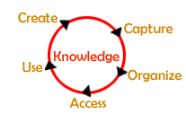
The Knowledge cycle
Knowledge is created. This happens in the heads of people.
Knowledge is captured. It is put on paper in a report.
Knowledge is organized, where it is classified and modified
Knowledge is shared and used.

Slide 14
Objectives of knowledge management
Create knowledge repositories
Improve knowledge access
Enhance the knowledge environment
Manage knowledge as an asset

Slide 15
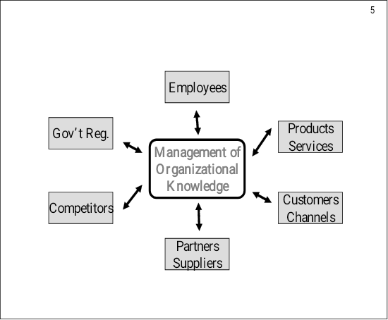
Organizational knowledge environments.
Sources from which organizations filter the information to build organizational knowledge

Slide 16

The KM cycle consisting of four steps that involves storage, processing and communication of information

Slide 17
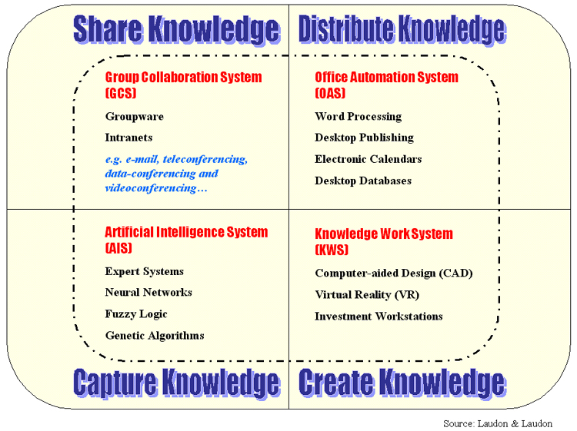
Technical domains of KM

Slide 18
Nature of Knowledge Management
Knowledge Management is about people.
Knowledge Management is orderly and goal-directed
Knowledge Management is ever-changing
Knowledge Management is value-added
Knowledge Management is visionary
Knowledge Management is complementary

Slide 19
Areas of research within each step of the knowledge management cycle
Observation and Analysis
Retrieval and filtering of data/information
Enabling access to salient environmental data
Sharing organizational goals and objectives
Theory Generation
Elimination of “silo” processing and reinvention
Fostering knowledge creation through small teams
Reduction of bureaucracy and formal meetings
Testing and Application
Enabling “start to finish” development and deployment
Effective measurement of business processes and knowledge assets
Management of changing requirements
Knowledge Consolidation
Methods of collective reflection
Building trust for the dissemination of knowledge
Retaining knowledge when employees leave

Slide 20
What is knowledge economy?
The World Bank Institute offers a formal definition of a knowledge economy as one that creates, disseminates, and uses knowledge to enhance its growth and development.
According to Housel and Bell a knowledge based economy is the one where knowledge is the main source of wealth, growth and employment, with a strong reliance on information technology.

Slide 21
Characteristics of knowledge economy
The economies is that of abundance
Distance is meaningless and hence operations will be faster
It is difficult to apply controls
Information leak is inevitable
Products developed based on knowledge will attract premium price
Human capital is a key component of value

Slide 22
KM Enabling Technology
Knowledge bases
Search engines
Document management systems (QA)
Notes:
Knowledge Management isn’t just about technology. There is a cultural aspect to Knowledge Management that is required for knowledge sharing to be effective. People must understand why it is important for themselves and the organization to share what they know, not just how to use a new technology.
But Knowledge Management can be ENABLED by technology and a few of the tools that can help manage our knowledge assets are:
Knowledge bases – databases where knowledge is stored. It’s important to capture the information that is in people’s heads in order for it to be useful to others.
Search engines – make the process of accessing the knowledge provided by others efficient and effective
Document management system (QA) – help ensure the integrity and accuracy of the knowledge we are sharing

Slide 23
Knowledge Management Technologies
(a) Intranet, Internet
(b) Groupware - Lotus Notes
(c) Intelligent Agents
(d) Mapping Tools
(e) Document Management
(f) Expert systems
(g) Knowledge base
(h) Artificial intelligence technology
(i) Case-based reasoning systems
(l) Data mining

Slide 24

What is KM strategy?
Knowledge management strategy is termed as an approach undertaken by an organization to use its information and knowledge resources for building competitive strength and sustainable growth for realizing that pursuing KM strategy can enable it to dramatically reduce cycle time and costs, increase sales, and to meet the customer needs.

Slide 25
ATTRIBUTES OF KNOWLEDGE
Knowledge exists everywhere
Knowledge is perishable
Knowledge is an asset
Use of knowledge does not consume it.
Transfer of knowledge does not result in losing it.
Knowledge is abundant, but the ability to use it is scarce.
Much of the organization’s knowledge goes out of the organization.
Knowledge can be tacit or explicit.

Slide 26
Five different types of knowledge
🗹 Knowing which information is needed (Know what);
🗹 Knowing how information must be processed (Know how);
🗹 Knowing why information is needed (Know why);
🗹 Knowing where information can be found to achieve a specific result (Know where);
🗹 Knowing when which information is needed (Know when).

Slide 27
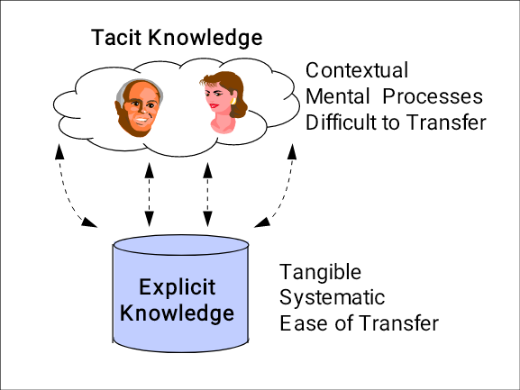

Slide 28
What is tacit knowledge?
Tacit knowledge refers to the personal knowledge embedded in individual experience and involves intangible factors, such as personal beliefs, perspective, and the value system. Tacit knowledge is hard to articulate with formal language (hard, but not impossible).

Slide 29
Capturing Tacit Knowledge
Expert Evaluation
Fuzzy Reasoning
Interviewing
Rapid Prototyping

Slide 30
Other Knowledge Capture Techniques
On-Site Observation (Action Protocol)
Brainstorming
Protocol Analysis (Think-Aloud Method)
Consensus Decision Making
Repertory Grid
Nominal Group Technique (NGT)
Delphi Method
Concept Mapping
Blackboarding

Slide 31
What is explicit knowledge?
Explicit knowledge refers to the contents that has been captured in some tangible form and can be articulated into formal language, including grammatical statements (words and numbers), mathematical expressions, specifications, manuals, etc. Explicit knowledge can be readily transmitted to others.

Slide 32
Comparison of properties of Tacit Vs Explicit knowledge
TACIT KNOWLEDGE
EXPLICIT KNOWLEDGE
Ability to adapt, to deal with new and exceptional situation.
Ability to disseminate, to reproduce, to access, and to reapply throughout the organization
Expertise, know-how, know-why, and care-why
Ability to teach, to train
Ability to collaborate, to share a vision, to transmit a culture
Ability to organize, to systematize; to translate a vision into a mission statement, into operational guidelines
Coaching and mentoring to transfer experiential knowledge on a one-to-one, face-to-face basis
Transfer of knowledge via products, services, and documented processes

Slide 33
Advantages and Disadvantages of the Tacit Knowledge Approach
Advantages:
1. Relatively easy and inexpensive to begin.
2. Employees may respond well to recognition of the (claimed) knowledge.
3. Likely to create interest in further knowledge management processes.
4. Important knowledge kept in tacit form may be less likely to “leak” to competitors.
Disadvantages:
1. Individuals may not have the knowledge they claim to have.
2. Knowledge profiles of individuals need frequent updating.
3. Ability to transfer knowledge constrained to moving people, which is costly and limits the reach and speed of knowledge dissemination within the organization.
4. Organization may lose key knowledge if key people leave the organization.

Slide 34
Advantages and Disadvantages of the Explicit Knowledge
Advantages:
1. Articulated knowledge (explicit knowledge assets) may be moved instantaneously
anytime anywhere by information technologies.
2. Codified knowledge may be proactively disseminated to people who can use specific forms of knowledge.
3. Knowledge that has been made explicit can be discussed, debated, and improved.
4. Making knowledge explicit makes it possible to discover knowledge deficiencies in the organization.
Disadvantages:
1. Considerable time and effort may be required to help people articulate their
knowledge.
2. Employment relationship with key knowledge workers may have to be redefined to motivate knowledge articulation.
3. Expert committees must be formed to evaluate explicit knowledge assets.
4. Application of explicit knowledge throughout organization must be assured by
adoption of best practices.

Slide 35
Four modes of knowledge creation – Nonaka's SECI Model
To tacit knowledge
To explicit knowledge
From tacit knowledge
Socialization
Externalization
From explicit knowledge
Internalization
Combination

Slide 36



Knowledge Spiral
1
Collaboration
Externalization
2
Messaging
Peer-2-Peer
eTeamSpaces/ eConferencing
Discussion Forums
Content Management
Knowledgebases
Workflow
4
Internalization
Combination
3
Portals
eLearning
Searching
Personalization
Push/Profiles
Knowledge Mapping
Data Mining
Synthesized Knowledge
Nonaka, I. And H. Takeuchi, The Knowledge-Creating Company. New York: Oxford Univ. Press, 1995.

Slide 37
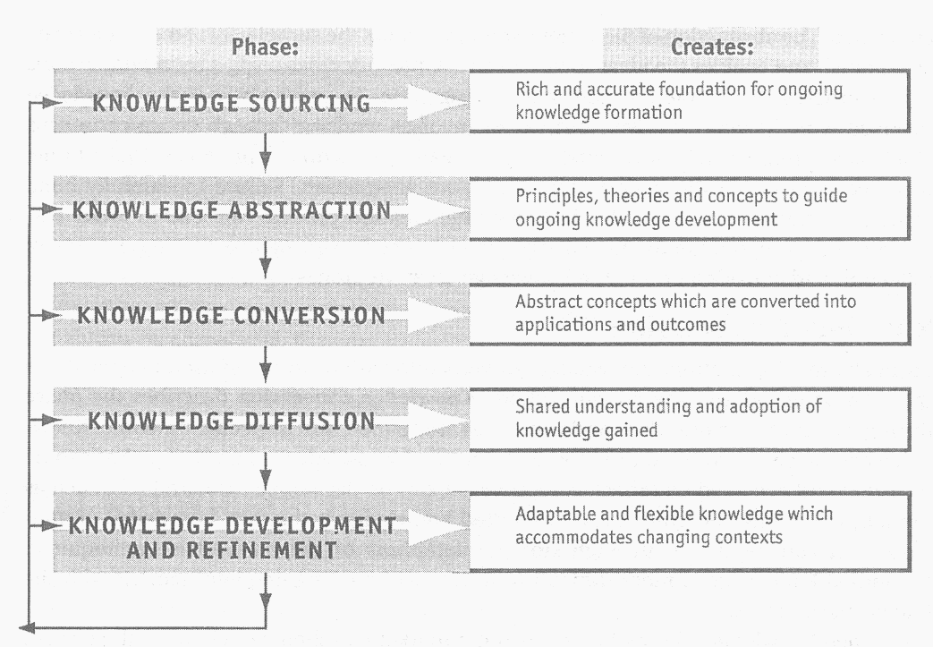
Phases of organizational knowledge creation

Slide 38
Knowledge sourcing
❶ Customer feedback
❷ Marketing expert’s opinion
❸ Previous promo schemes data and their success and failures
❹ Available secondary data
❺ Lessons from competitors similar schemes
❻ Contributions from employees concerned with such schemes

Slide 39
Knowledge abstraction
It is process of generating the general principles and concepts to guide the construction of the new knowledge, after analyzing the sources of knowledge.
It helps to frame the insights gained from knowledge sourcing and to extrapolate new knowledge from the basic guidelines and issues that have emerged.

Slide 40
Knowledge conversion
Knowledge conversion describes the phase during which the various ideas and principles are refined into specific outcomes that can be tested and shared with others

Slide 41
Knowledge diffusion
Knowledge diffusion is the spread of knowledge once it is codified or embodied
In organizational settings, diffusion can occur through communication media such as newsletters, the Intranet, meetings, seminars etc., modeling of new practices, and demonstrations or coaching in specialized procedures

Slide 42
WHAT IS ORGANISATIONAL LEARNING?
The term organizational learning refers to continuous improvement of existing approaches and processes and adaptation to change, leading to new goals and/or approaches.

Slide 43
Benefits of organizational learning
(1) Enhancing value to customers through new and improved products and services;
(2) Developing new business opportunities;
(3) Reducing errors, defects, waste, and related costs;
(4) Improving responsiveness and cycle time performance;
(5) Increasing productivity and effectiveness in the use of all resources throughout the Organization;
(6) Enhancing the organization’s performance in fulfilling its public responsibilities and service as a good citizen

Slide 44
What is a ‘learning organization’?
A learning organization is an organization which has in place systems, mechanisms and processes that are used to continually enhance its capabilities and those who work with it or for it, to achieve sustainable objectives - for them and the communities in which they participate.

Slide 45
Key characteristics of learning organization
Team work and team learning.
Systemic thinking and mental models.
Free vertical and horizontal flow of information.
Education and training of the whole workforce.
Learning reward system for employees.
Continuous improvement of work.
Flexibility of employees and company strategies.
Decentralized hierarchies and participative management.
Constant experimentation.
Supportive corporate cultures.

Slide 46
The five learning disciplines of Peter Senge
(1) Personal Mastery
(2) Mental Models
(3) Shared Vision
(4) Team Learning
(5) Systems thinking

Slide 47
WHAT IS KNOWLEDGE CODIFICATION?
Knowledge codification is organizing and representing knowledge before it is accessed by authorized personnel.

Slide 48
The knowledge developer should note the following points before initiating knowledge codification:
Recorded knowledge is often difficult to access (because it is either fragmented or poorly organized).
Diffusion of new knowledge is too slow.
Knowledge is nor shared, but hoarded (this can involve political implications).
Often knowledge is not found in the proper form.
Often knowledge is not available at the correct time when it is needed.
Often knowledge is not present in the proper location where it should be present.
Often the knowledge is found to be incomplete.

Slide 49
Codification Tools
(a) Knowledge Maps
(b) Decision Table
(c) Decision Tree
(d) Frames
(e) Production Rules
(f) Case-Based Reasoning
(g) Knowledge-Based Agents

Slide 50
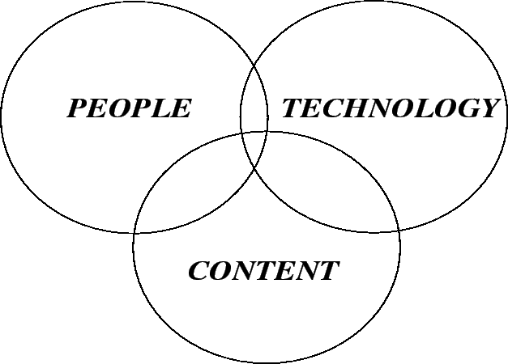
KNOWLEDGE MANAGEMENT INFRASTRUCTURE
Knowledge management infrastructure is a prerequisite to knowledge sharing which is viewed as a combination of people, technology and content.

Slide 51
WHAT IS A KNOWLEDGE REPOSITORY?
A Knowledge Repository is a computerized system that systematically and continuously captures, organizes, categorizes and analyses an organization’s knowledge assets.
The repository can be searched and data can be quickly retrieved.
It is a collaborative system where people can query and browse both structured and unstructured information in order to retrieve and preserve organizational knowledge assets and facilitate collaborative working.

Slide 52
What are the contents of knowledge repository?
factual (terminology, specific details and elements);
conceptual (theories, models, principles and generalizations);
procedural (skills, algorithms, techniques and methods) and
meta-cognitive (knowledge about knowledge, i.e. learning, thinking, problem solving).

Slide 53
Features of knowledge repository
links to organizational and external sources
search services to help users find required objects or sources
reference materials and services
frequently asked questions (FAQs)
a site where solution may be shared
a help services to support users who are unfamiliar with the system
a contribution channel to allow easy linkage of new materials

Slide 54
KNOWLEDGE MANAGEMENT APPLICATIONS
Integrative applications exhibit a sequential flow of explicit knowledge into and out of the repository.
Interactive applications are focused primarily on supporting interaction among people holding tacit knowledge.
Composite applications deals with segmenting multiple repositories

Slide 55
WHAT IS A COLLABORATIVE PLATFORM?
Collaborative platform is a tool that supports team members or other tools that share information and contribute to knowledge management system.
The user can either search for content - the pull approach to content delivery – or subscribe to content, that is, have content pushed to him or her.

Slide 56
WHAT IS COLLABORATIVE FILTERING?
Collaborative filtering or deduction, gathers knowledge on general user traits, and models this into a profile.
A profile is compared to other profiles by detecting similarities and opposites.
It then makes predictions upon these comparisons

Slide 57
Tools for Collaborative Platform
Intranets
Portals
Chat (Audio and text)
Bulletin board
Discussion groups (newsgroups)
Whiteboard
File sharing tools
Presentation tools
Text tools
Email

Slide 58
WHAT IS ORGANISATIONAL CULTURE?
Organizational culture describes the collective perceptions, beliefs and values of employees in the workplace.
Culture is influenced at a number of levels, from the rules and values adopted by individuals to the alliances formed within the organization
Stories, interactions, anecdotes and shared reminiscences all contribute to the building of culture.

Slide 59
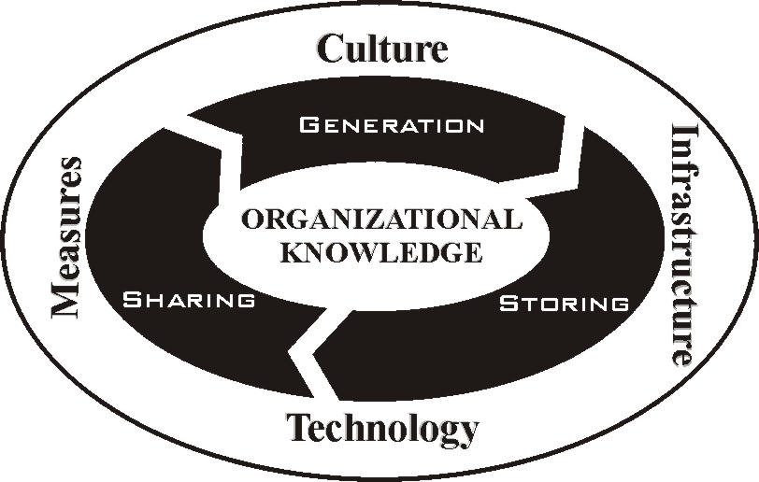
Organizational Culture

Slide 60
Values in knowledge cultures
Regular communication across levels and organizational units,
Colleagues invitation for sharing and learning,
Working together is seen as a core activity,
Learning is incorporated into the work community and practice,
New ideas are welcomed and explored,
Innovative ideas and solutions are developed through combined efforts,
Openness, honesty and concern for others is encouraged,

Slide 61
Improving knowledge culture
Stress the need to share
Promote trust
Beware of information overload
Have the correct tools
Change the sharers
Report small problems
Build a solid relationship with your vendor

Slide 62
Knowledge Culture Enablers
CORE VALUES
2. STRUCTURALSUPPORT
3. ENACTEDVALUES
4. INTERACTIONWITH COLLEAGUES

Slide 63
Communities of Practice
(a) Communities of Practice (CoPs) are groups of people in organizations that form to share what they know, to learn from one another regarding some aspects of their work and to provide a social context for that work.
(b) Communities of practice are groups of people with common interest who meet to share their insights in order to develop better solutions to problems or challenges.

Slide 64
Importance of Communities to Organizations
They are nodes for the exchange and interpretation of information.
They can retain knowledge in "living" ways, unlike a database or a manual.
They can steward competencies to keep the organization at the cutting edge.
They provide homes for identities.

Slide 65
ORGANISATIONAL MEMORY
It is a record of accumulated knowledge about the organization to support knowledge-intensive work and of alleviating the risk of “corporate amnesia” due to experts taking away their knowledge when they leave.

Slide 66
KM TOOLS AND TECHNIQUES
They are technologies used to facilitate primarily communication, collaboration, and content management for better knowledge capture, sharing, dissemination and application.
Deals with the information overload that is plaguing most organizations that have launched an intranet, enterprise resource planning (ERP) or business intelligence system.

Slide 67
Knowledge capture and creation tools
Content Creation Tools
(a) Authoring tools
Data Mining and Knowledge Discovery
Blogs
Content management tools

Slide 68
What is Data Mining?
A computer technique for extracting meaningful knowledge from masses of data. Using artificial intelligence methods it identifies unanticipated patterns by considering the interaction of many more variables than is achievable by humans. Contrast with text mining.

Slide 69
Data mining tools
Statistical analysis tools (e.g. SAS).
Data mining suites (e.g. enterprise Miner).
Consulting/outsourcing tools such as EDS, IBM, and Epsilon. (Note that these are models, not just software).
Data visualization software

Slide 70
Knowledge sharing and dissemination tools
Groupware and Collaboration Tools
Wikis
Networking technologies

Slide 71
Knowledge acquisition and application tools
Intelligent Filtering Tools
Adaptive technologies

Slide 72
KNOWLEDGE MANAGEMENT AND MEASUREMENTS
Measurement is the assignment of numerals to things according to any determinative, non-degenerate, rule
Determinative means the constant assignment of numerals given constant conditions
Non-degenerate means allowing for the possibility of assignment of different numerals under varying conditions
In knowledge management measurement, we are trying to select and/or formulate those concepts useful in measuring and influencing knowledge management performance

Slide 73
KNOWLEDGE MEASUREMENT TECHNIQUES
Intangible asset measurement
Intangible assets monitor
IC Rating
Balanced Scorecard

Slide 74
What is Balanced Scorecard?
It is a performance measurement system that incorporates a balanced set of measures, both financial and non-financial. It adds customer, internal processes and innovation and learning indicators to financial ones to provide a more balanced view.

Slide 75
WHAT IS KNOWLEDGE AUDIT?
Knowledge audit is a systematic examination and evaluation of organizational knowledge health, which examines organization’s knowledge needs, existing knowledge assets/resources, knowledge flows, future knowledge needs, knowledge gap analysis as well as the behavior of people in sharing and creating knowledge.

Slide 76
Definition of Knowledge Audit
The systematic analysis of an organization's information and knowledge entities and their key attributes, such as ownership, usage and flows, mapped against user and organizational knowledge needs. The terms information audit, knowledge audit, knowledge inventory and knowledge mapping are often used synonymously.

Slide 77
Tasks in Knowledge Audit
1. Create a data, information and knowledge systems database
2. Identify areas of organizational quick gain
3. Perform process mapping
4. Organize focus groups
5. Design and pilot knowledge needs survey
6. Organize feedback session
7. Draft strategy

Slide 78
Components of a Knowledge Audit
Knowledge need analysis
Knowledge inventory analysis
Knowledge Flow analysis
Knowledge mapping

Slide 79
Classification of knowledge professionals based on skills
Knowledge and Innovation Professionals
Knowledge Management Professionals
Knowledge Catalogers, Researchers and media Specialists
Knowledge and Competitive Intelligence Professionals
Knowledge and Strategic Integration Professionals
Knowledge Academicians, Theorists and Visionaries
Knowledge facilitators, trainers and Corporate Educators
Knowledge and Expert Systems Professionals

Slide 80
Who is a Knowledge Worker?
An individual whose primary contribution is through the knowledge that they possess or process. This contrasts with workers whose work is predominantly manual or following highly specified procedures with little scope for individual thought.

Slide 81
Career Opportunities in Knowledge Management
Managerial positions
Chief Learning Officers (CLO)
Chief Knowledge Officers (CKO)
Knowledge Managers
Knowledge Initiative Managers
Knowledge Management Experts
Knowledge Transfer Experts
Knowledge Engineers
Knowledge Strategist Contd..

Slide 82
Chief Knowledge Officer (CKO)
A senior executive, often at board level with responsibility for an organization's knowledge agenda. Unlike other officers, they may not manage a knowledge 'function', although they may directly manage a small knowledge team, and hold budget responsibilities.
Contd..

Slide 83
Technical positions
Knowledge Analyst
Knowledge Mapping Specialists
Knowledge Content Creators
Knowledge-Base Architects and Administrators
Contd..

Slide 84
Non-Management Positions
Librarians
Cybrarians
Information Brokers

